Slide 1

2020-01 CAU
Natural Language Processing and Information Retrieval
Evaluate IR System
Retrieving whether the query indicates
female protagonist feature films or male’s.
20161856 Jihyo Han
Notes:
I’ll present about the evaluation of my IR system, which retrieves whether the query indicates female protagonist feature films or male’s.

Slide 2

Contents
Introduction – About previous project…
Development – Environment, Code details
Conclusion – Results
Notes:
The contents are like that

Slide 3
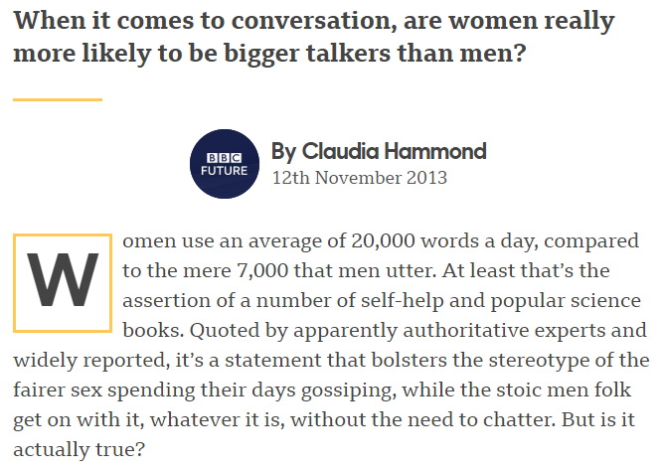
Introduction – About previous project…
?
Does women
really talk a lot
than men do?
Assumptions
Female leading movies would have much more words in film than male leading movies do.
Vocabularies would be more diverse and feminine in female leading movies rather than male movies.
https://www.bbc.com/future/article/20131112-do-women-talk-more-than-men
Notes:
In the last project, I was curious about the stereotype that does women really talk a lot than men do, so I tried to figure it out by analyzing the movie scripts dividing to two datasets based on the movies that one is female starring while on the other hand, males are the main characters. I set two assumptions that female movies would have more vocabularies and word counts than male films do, but in conclusion,
my hypothesis were wrong.

Slide 4
MALE
word counts 35441 Vocabularies 15859
FEMALE
word counts 34884 Vocabularies 15302
Word frequency & number of vocabularies
Introduction – About previous project…
Notes:
the differences were not that dramatic, and also the vocabularies are not showing the markable inclination like “feminine” or “masculine” words.
So in this project, I tried to design an information retrieval system which can find out whether the input query indicates female movie scripts or male movie scripts.

Slide 5

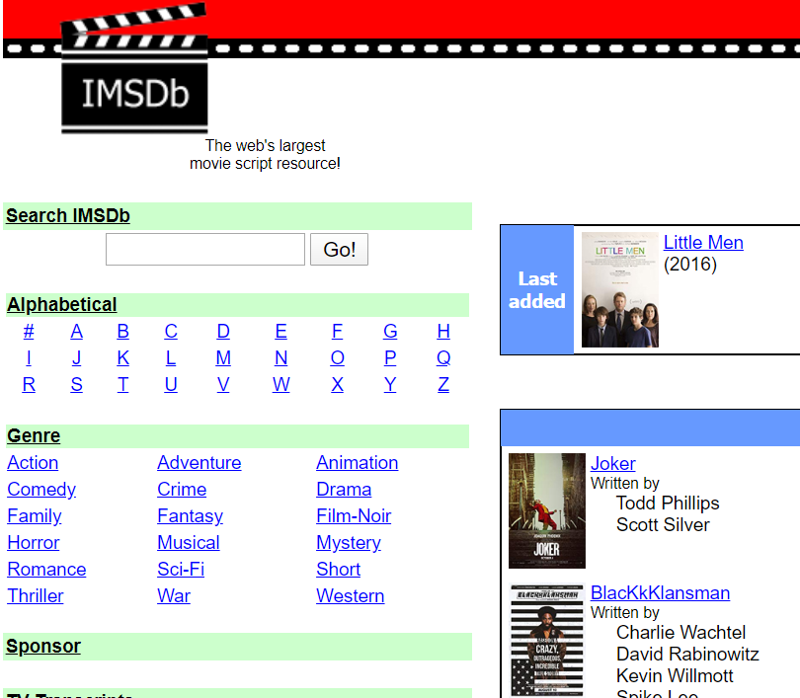
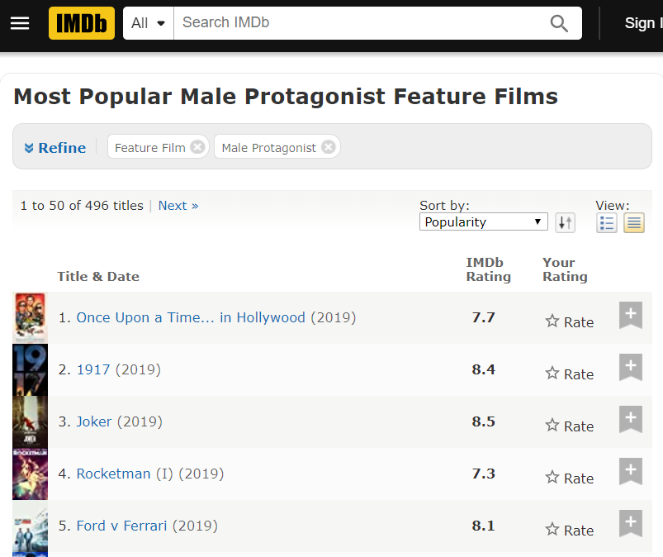
Development - Environment
Jupyter notebook
- ipython 7.8.0
- Python 3.7.4
Movie Scripts
From IMSDb
https://www.imsdb.com/
Select 50 Movies each based on IMDb investigation
regardless of genres
Male: https://www.imdb.com/search/keyword/?keywords=male-protagonist&sort=moviemeter,asc&mode=simple&page=1&ref_=kw_nxt&title_type=movie
Female: https://www.imdb.com/search/keyword/?keywords=female-protagonist&mode=simple&page=1&ref_=kw_nxt&title_type=movie&sort=moviemeter,asc
Notes:
To develop, I used jupyter notebook with python version 3.7.4, and like before, the movie scripts are chosen based on IMDb investigation and get 50 films’ scripts each from IMSDb.

Slide 6

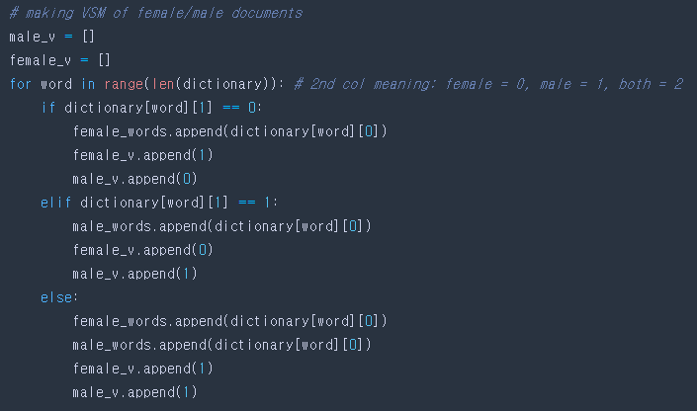

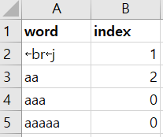

Document Indexing & Vectorization
Since there’re only two datasets(f/m), I made inverted index as shown here in the last project.
In total_word_count.xlsx file, the index column means where the word is included. 0: female, 1: male, 2: both
Then, make each vectors of female/male words list, whose size is same as the total words list.
ex) female_v: [1, 0, 0, 0, 1, …]
Document Indexing Time : 3.8 sec
Development – Code Details

Slide 7
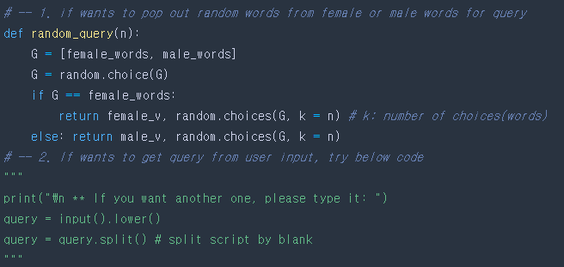
Creating Random Queries
For experimenting repetitive input of query and information retrieval, I defined a function of creating random query which contains n number of words from female/male words list that is also chosen randomly.
Of course, the user can type own query as an input, but in this presentation, I’ll only introduce the results while using random queries.
Development – Code Details

Slide 8
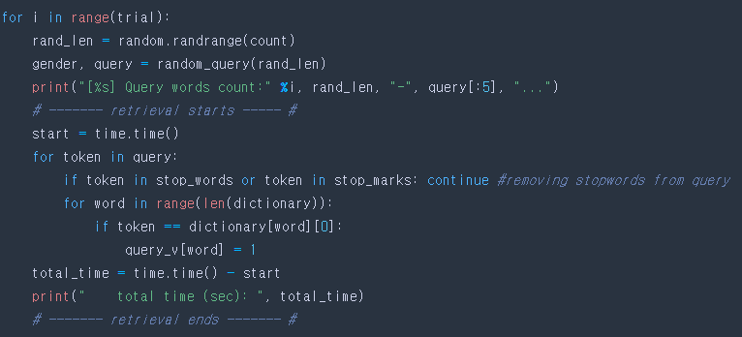
Information Retrieval
Choose rand_len(Max. count) number of words from random words list(f/m).
Tokenize this query and remove the stop words.
By comparing between the token from the query and the total words list, the query vector is created.
Repeat this process for trial times.
Development – Code Details
Notes:
* -- 2. Notice that random query doesn’t have stop words because it was already chosen from preprocessed words list.

Slide 9
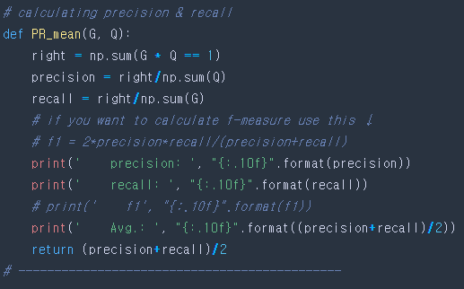
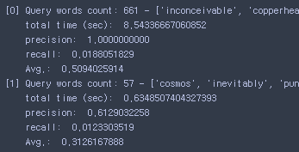
Calculating Precision and Recall for Evaluation
To evaluate IR system, calculate precision and recall by comparing between the query and query’s mother which could be female/male words list.
Also, because here we use multiple queries, calculate MAP(Mean Average Precision) too.
Development – Code Details

Slide 10



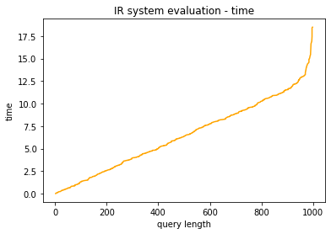
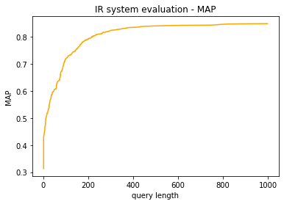
Conclusion – Results
Notes:
So for the evaluation, I tried 1000 random queries whose average words count is about 486, while the longest is 998, and the shortest is 2.
As the results, we could plot the graph of correlation between query length and retrieval time, and also between query length and MAP.
We could see that it took about 6 seconds in average, while the highest is 18 seconds, and the lowest is almost 0 seconds. And the total MAP value is 80%.
Refer to this figure, I could draw out that the more words query have, the more information to search for, so it is no wonder that the system's performance improves proportionally. However, this is meaningless, because it takes that much time, and we can’t increase the length of the query forever.
Honestly, this is the limit of my IR system, due to using Boolean model, not the VSM. Thus in the next project, I want to use each words counts of each documents like tf-idf, to make ranked documents effectively.

Slide 11
Thank you !

